Slide 1
Council of Agencies Serving South Asians (CASSA)
Facilitating Hate Crime Reporting
Combined Training materials provided to Police Services in Toronto, Peel Region, York Region and Ottawa

Slide 2
Land Acknowledgement
The work of the Council of Agencies Serving South Asians (CASSA) takes place on the traditional Indigenous territories of the Huron-Wendat, Haudenosaunee & Mississaugas of the New Credit
Indigenous communities are particularly vulnerable to discrimination and bias, including hate crimes, overpolicing and dispropotionate rates of incarceration

Slide 3
Understanding Hate in Canada
Hate in Canada is deeply rooted in the country’s colonial history
The conscious and unconscious biases embedded in Canadian society further harm, victimize, and traumatize, marginalized communities making them more vulnerable to experiencing hate and the associated physical, mental, emotional, and psychosocial impacts

Slide 4
Project Overview
Provincially funded by the Safer and Vital Communities Grant
Partnered with Toronto Police Service, York Regional Police, Peel Regional Police, and Ottawa Police Service

Slide 5
Hate Crimes Introduction

Slide 6
Key Definitions
According to the Criminal Code of Canada there are no formal definitions of hate crime.
Hate crime

Slide 7
Key Definitions
According to the Criminal Code of Canada…
What is more commonly referred to as a “hate crime” in Canada is legally known as a “hate-motivated crime” in Canada currently.
Hate-motivated crime
Hate crime

Slide 8
Key Definitions
Hate-Motivated Crime
Criminal offence against a person or their property
Ex. Physical assault, destruction of property, vandalism
Crime is motivated by suspect’s hate, prejudice or bias against the victim’s real or perceived identity*
“Hate” is a sentencing feature added onto the criminal charge
*Identifiable group:
Ancestry, race, national or ethnic origin, language, colour, religion, class, sex, age, mental or physical disability, gender identity, sexual orientation, or other similar factor

Slide 9
Key Definitions
Hate Incident
Non-criminal action or behaviour against a person
Ex. Use of racial slurs, shouting and verbally abusing a person
Incident is motivated by suspect’s hate, prejudice or bias against the victim’s real or perceived identity*
*Identifiable group:
Ancestry, race, national or ethnic origin, language, colour, religion, class, sex, age, mental or physical disability, gender identity, sexual orientation, or other similar factor

Slide 10
Key Definitions
Hate Speech
3 offences under the Criminal Code of Canada that pertain to Hate and Hate Propaganda
S318: Advocating Genocide**
S319(1): Public Incitement of Hatred
S319(2): Wilful Promotion of Hatred**
Need consent of Attorney General to lay hate speech charge**
*Identifiable group:
Ancestry, race, national or ethnic origin, language, colour, religion, class, sex, age, mental or physical disability, gender identity, sexual orientation, or other similar factor

Slide 11
CASSA Findings:
Hate Crime Reporting Practices

Slide 12
Hate Crime Reporting Practices
Statistics on regional proportions of reporting to police and experiences.
Region | % reporting to police | % found process to report to police difficult
Toronto | 71% | 11%
Ottawa | 80% | 9%
Peel | 66% | 14%
York | 94% | 3%
Sampling bias
Qualitative findings display a different story about difficulties with reporting

Slide 13
Barriers to Reporting Hate Crimes
What is the Community Saying?
In line with this, through analyzing the interviews and community forums across jurisdictions, our team identified four overarching themes with barriers to reporting hate motivated crimes.

Slide 14
Barriers to Reporting Hate Crimes
What is the Community Saying?
What is the Community Saying?
LOGISTICS
Reporting processes are intimidating and inaccessible
LOGISTICS
Reporting processes are intimidating and inaccessible
LOGISTICS
Reporting processes are intimidating and inaccessible
Logistics encompasses how reporting processes are intimidating and inaccessible.
Under this theme, community members shared how there is a lack of clarity in how to access hate crime reporting, a lack of clarity in what hate activity is and how hate crime prosecutions will unfold, and other barriers to reporting including language, psychosocial and cultural factors, socioeconomic, and accessibility barriers.

Slide 15
Barriers to Reporting Hate Crimes
What is the Community Saying?
What is the Community Saying?
LOGISTICS
Reporting processes are intimidating and inaccessible
LOGISTICS
Reporting processes are intimidating and inaccessible
LOGISTICS
Reporting processes are intimidating and inaccessible
SYSTEMIC FAILURES
Victims feel like the perpetrators when reporting to police, or during investigations
W
W
W
Systemic failures encompasses how victims feel like the perpetrators when reporting to police, or during investigations, and describes how community members feel hesitant to report to police as they are worried about, or experienced, being dismissed when reporting in person or that the power dynamic scared them off from reporting.

Slide 16
Barriers to Reporting Hate Crimes
What is the Community Saying?
What is the Community Saying?
LOGISTICS
Reporting processes are intimidating and inaccessible
LOGISTICS
Reporting processes are intimidating and inaccessible
LOGISTICS
Reporting processes are intimidating and inaccessible
SYSTEMIC FAILURES
Victims feel like the perpetrators when reporting to police, or during investigations
W
W
W
Lack of communication and accountability between police and the victim and affected community
RELATIONSHIPS
Relationships encompasses how there is a lack of communication and accountability between police and the victim and affected community, and that there is a general lack of cultural sensitivity and understanding from police officers.
O
O

Slide 17
Barriers to Reporting Hate Crimes
What is the Community Saying?
What is the Community Saying?
LOGISTICS
Reporting processes are intimidating and inaccessible
LOGISTICS
Reporting processes are intimidating and inaccessible
LOGISTICS
Reporting processes are intimidating and inaccessible
SYSTEMIC FAILURES
Victims feel like the perpetrators when reporting to police, or during investigations
W
W
W
Lack of communication and accountability between police and the victim and affected community
RELATIONSHIPS
Lack of community awareness about available resources to report hate crimes and seek support
INFRASTRUCTURE
O
O
T
T

Slide 18
Infrastructure continued…
Lastly, infrastructure describes the lack of community awareness about available resources and places to report hate crimes through no fault of their own, but on part of the police and related reporting services. this has led to an increase in crimes going unreported which misleads hate crime statistics and reporting.
This also leaves victims and the affected community vulnerable to future crimes and adverse health and social outcomes.

Slide 19
It would be nice to have a hate crime hotline that is linked to regional police services.
I think part of the problem is that no one knows if these hotlines exist, which is a problem in itself.
— Community Member

Slide 20
Hate Crime Reporting Practices
We found that >25% across the four regions have experience reporting to non-police organizations.
Region | No. Participants | % with experience reporting to non-police organizations
Toronto | 1,629 | 25%
Ottawa | 1,146 | 76%
Peel | 205 | 65%
York | 1,816 | 94%

Slide 21
How to Take Hate-Motivated Crime/Incident Reports:
A Step-by-Step Guide for Organizations

Slide 22
How to Take Hate-Motivated Crime/Incident Reports:
A Step-by-Step Guide for Organizations
Would victim like to pursue legal/criminal action against perpetrator?
Gather personal information if consent is provided
Assess need for interpreter
Gather hate-motivated crime/incident report
Gather and document all evidence from victim
Follow-up with victim on social support, legal, and other resources
Explain nuances of criminal proceedings (i.e., hate is sentencing feature, unlikely to get conviction without sufficient evidence)
Reporting on behalf of self or another?
Does victim agree to have their report shared with local police services?
Follow-up with police service
Would victim like to de-identify their data?
Advocate for the victim and your clients

Slide 23
How to Take Hate-Motivated Crime/Incident Reports:
A Step-by-Step Guide for Organizations
Would victim like to pursue legal/criminal action against perpetrator?
Gather personal information if consent is provided
Assess need for interpreter
Gather hate-motivated crime/incident report
Gather and document all evidence from victim
Follow-up with victim on social support, legal, and other resources
Explain nuances of criminal proceedings (i.e., hate is sentencing feature, unlikely to get conviction without sufficient evidence)
Reporting on behalf of self or another?
Does victim agree to have their report shared with local police services?
Follow-up with police service
Would victim like to de-identify their data?
Advocate for the victim and your clients

Slide 24
How to Take Hate-Motivated Crime/Incident Reports:
A Step-by-Step Guide for Organizations
Would victim like to pursue legal/criminal action against perpetrator?
Gather personal information if consent is provided
Assess need for interpreter
Gather hate-motivated crime/incident report
Gather and document all evidence from victim
Follow-up with victim on social support, legal, and other resources
Explain nuances of criminal proceedings (i.e., hate is sentencing feature, unlikely to get conviction without sufficient evidence)
Reporting on behalf of self or another?
Does victim agree to have their report shared with local police services?
Follow-up with police service
Would victim like to de-identify their data?
Advocate for the victim and your clients
What (type of discrimination, description)
Where (city, site)
When (date, time)
Reasons for perceiving hate motivation
Demographic info. (victim + perp.): age, race/ethnicity, culture, colour, religion, sex, gender, disability, etc.
Statement
Prior history with perpetrator

Slide 25
How to Take Hate-Motivated Crime/Incident Reports:
A Step-by-Step Guide for Organizations
Would victim like to pursue legal/criminal action against perpetrator?
Gather personal information if consent is provided
Assess need for interpreter
Gather hate-motivated crime/incident report
Gather and document all evidence from victim
Follow-up with victim on social support, legal, and other resources
Explain nuances of criminal proceedings (i.e., hate is sentencing feature, unlikely to get conviction without sufficient evidence)
Reporting on behalf of self or another?
Does victim agree to have their report shared with local police services?
Follow-up with police service
Would victim like to de-identify their data?
Advocate for the victim and your clients
What (type of discrimination, description)
Where (site and city)
When
Reasons for perceiving hate motivation
- Demographic info. (victim + perp.): age, race/ethnicity, culture, colour, religion, sex, gender, disability, etc.
- Statement
- Prior history with perp.

Slide 26
How to Take Hate-Motivated Crime/Incident Reports:
A Step-by-Step Guide for Organizations
Would victim like to pursue legal/criminal action against perpetrator?
Gather personal information if consent is provided
Assess need for interpreter
Gather hate-motivated crime/incident report
Gather and document all evidence from victim
Follow-up with victim on social support, legal, and other resources
Explain nuances of criminal proceedings (i.e., hate is sentencing feature, unlikely to get conviction without sufficient evidence)
Reporting on behalf of self or another?
Does victim agree to have their report shared with local police services?
Follow-up with police service
Would victim like to de-identify their data?
Advocate for the victim and your clients
What (type of discrimination, description)
Where (site and city)
When
Reasons for perceiving hate motivation
- Demographic info. (victim + perp.): age, race/ethnicity, culture, colour, religion, sex, gender, disability, etc.
- Statement
- Prior history with perp.

Slide 27
How to Take Hate-Motivated Crime/Incident Reports:
A Step-by-Step Guide for Organizations
Would victim like to pursue legal/criminal action against perpetrator?
Gather personal information if consent is provided
Assess need for interpreter
Gather hate-motivated crime/incident report
Gather and document all evidence from victim
Follow-up with victim on social support, legal, and other resources
Explain nuances of criminal proceedings (i.e., hate is sentencing feature, unlikely to get conviction without sufficient evidence)
Reporting on behalf of self or another?
Does victim agree to have their report shared with local police services?
Follow-up with police service
Would victim like to de-identify their data?
Advocate for the victim and your clients
What (type of discrimination, description)
Where (site and city)
When
Reasons for perceiving hate motivation
- Demographic info. (victim + perp.): age, race/ethnicity, culture, colour, religion, sex, gender, disability, etc.
- Statement
- Prior history with perp.

Slide 28
How to Take Hate-Motivated Crime/Incident Reports:
A Step-by-Step Guide for Organizations
Would victim like to pursue legal/criminal action against perpetrator?
Gather personal information if consent is provided
Assess need for interpreter
Gather hate-motivated crime/incident report
Gather and document all evidence from victim
Follow-up with victim on social support, legal, and other resources
Explain nuances of criminal proceedings (i.e., hate is sentencing feature, unlikely to get conviction without sufficient evidence)
Reporting on behalf of self or another?
Does victim agree to have their report shared with local police services?
Follow-up with police service
Would victim like to de-identify their data?
Advocate for the victim and your clients
What (type of discrimination, description)
Where (site and city)
When
Reasons for perceiving hate motivation
- Demographic info. (victim + perp.): age, race/ethnicity, culture, colour, religion, sex, gender, disability, etc.
- Statement
- Prior history with perp.

Slide 29
How to Take Hate-Motivated Crime/Incident Reports:
A Step-by-Step Guide for Organizations
Would victim like to pursue legal/criminal action against perpetrator?
Gather personal information if consent is provided
Assess need for interpreter
Gather hate-motivated crime/incident report
Gather and document all evidence from victim
Follow-up with victim on social support, legal, and other resources
Explain nuances of criminal proceedings (i.e., hate is sentencing feature, unlikely to get conviction without sufficient evidence)
Reporting on behalf of self or another?
Does victim agree to have their report shared with local police services?
Follow-up with police service
Would victim like to de-identify their data?
Advocate for the victim and your clients
What (type of discrimination, description)
Where (site and city)
When
Reasons for perceiving hate motivation
- Demographic info. (victim + perp.): age, race/ethnicity, culture, colour, religion, sex, gender, disability, etc.
- Statement
- Prior history with perp.

Slide 30
Community-based Reporting / Support Services
Examples
Project 1907
Online reporting tool for an incident of anti-Asian racism
(incl. other demographics as well)
https://www.project1907.org/report
Asilu Collective
Anonymous Reporting for Ottawa Schools: Incidents of Police Involvement and more (online reporting)
https://docs.google.com/forms/d/e/1FAIpQLSc5Sg15iTio5a7bL2R1UqUzi53uQ3peDWzm7jfukJG6NQozfw/viewform
Riverdale Immigrant Women’s Centre (RIWC): Islamophobia Support Line
Live support for women and non-binary people who experienced a hate crime incident and want to learn more about how to report a hate crime or find out more about resources in the community
Phone No: 416-613-8729 (Mon-Thurs, 10 am-4 pm)
Email: helpline@riverdalehub.ca

Slide 31
Capacity-building
Resources for Organizations & Victims
Refer your networks and clients to our in-house produced resources
Amplify our campaign and resources
Other key resources
https://www.cassa.ca/eradicatehate/
https://www.cassa.ca/eradicatehate-anti-hate-conversation-series/#about-ahclg
https://www.cassa.ca/eradicatehate-2-0/

Slide 32
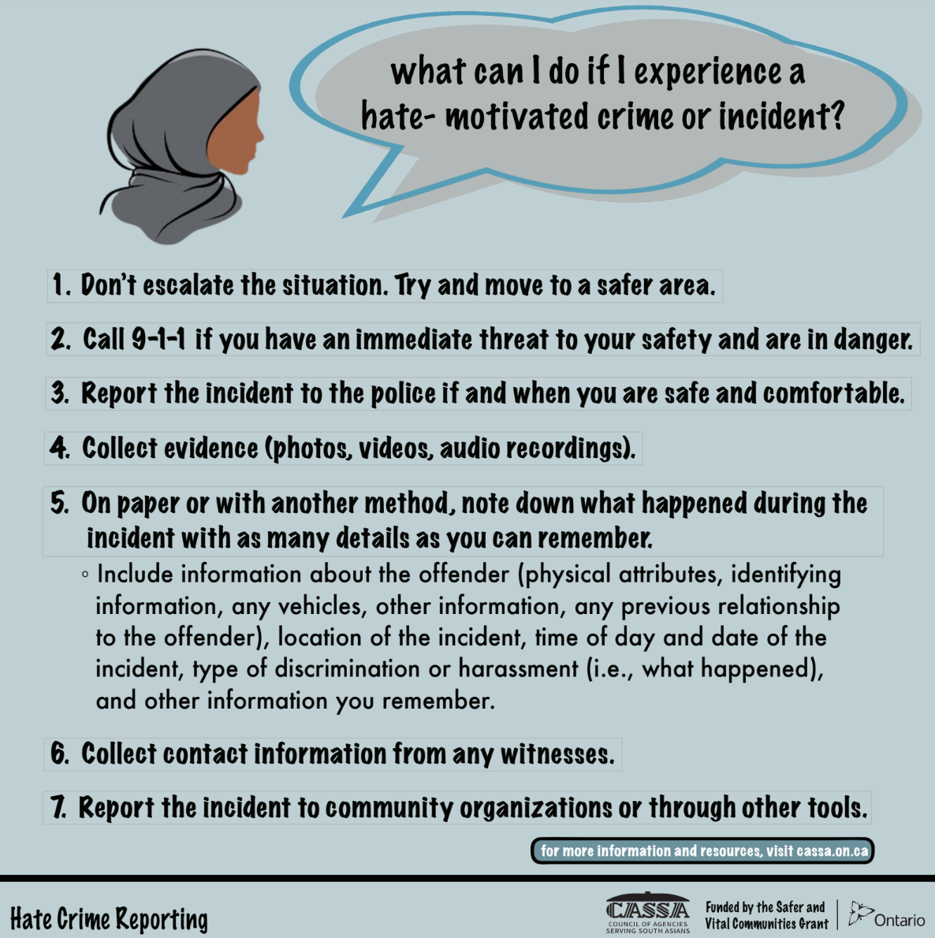
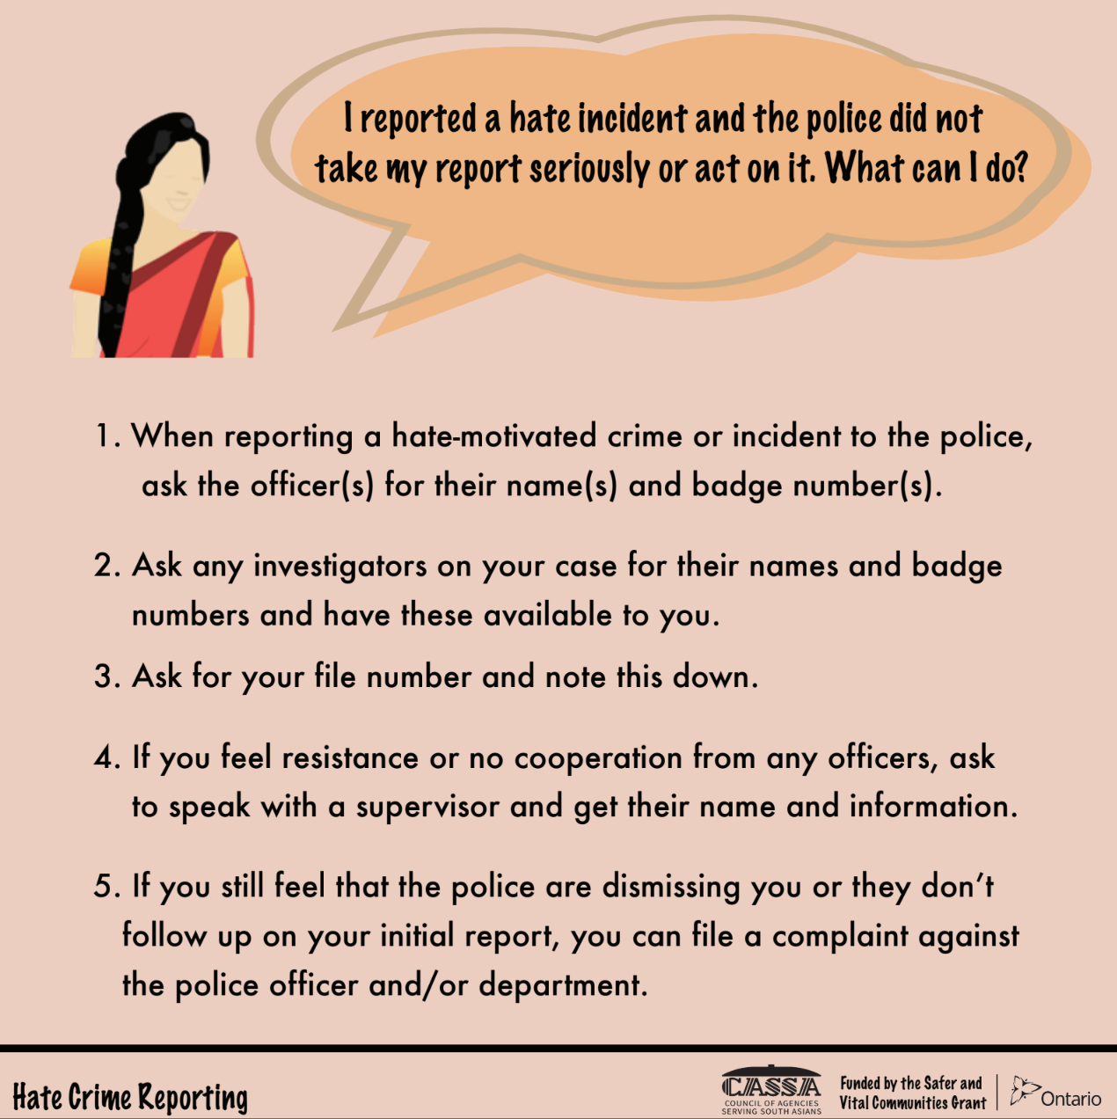
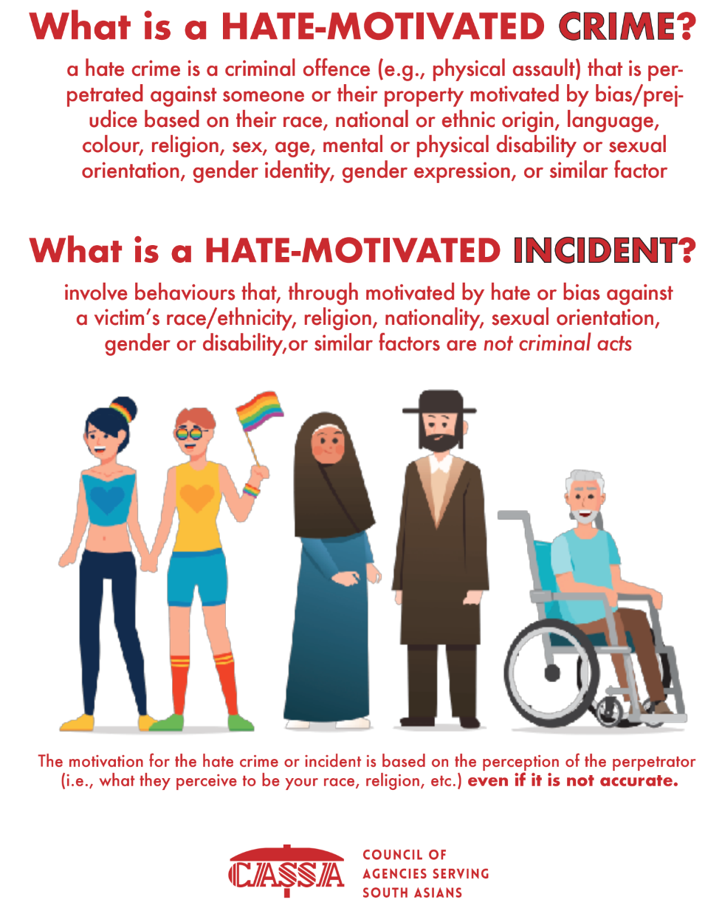
Current Campaign
https://drive.google.com/drive/folders/12uD4INaXjFTiLTL3U1ZHDvQJIrn6k3w-?usp=sharing
All content available in English, Urdu, Punjabi, Tamil, Arabic, Simplified Chinese and French
All content available on CASSA”s website

Slide 33
Thanks!
Questions?
Any resources you would like to submit?
https://forms.gle/im8UAfSDxCPJozM96

